Slide 1


Open Technology Workshops
Anonymous browsing with Tor

Slide 2
Open Technology Workshops
APPLICATIONS
Anonymous browsing with Tor

Slide 3

Open Technology Workshops
To Tor or not to Tor?
Do you need Privacy or Anonymity?
Privacy is about people knowing who you are but not knowing what you are doing.
Anonymity is about people knowing what you are doing but not knowing who you are.
Tor and TailsOS can be effective tools in your strategy to stay safe.
Tor Project - https://www.torproject.org
TailsOS - https://tails.net
The Hitchhiker’s Guide to Online Anonymity - https://anonymousplanet.org
Notes:
Open source means that the source code is available to the public and has usually has a permissive license for use. This contrasts with closed source software that has a restrictive license and the source code is not available.
Sources:
https://www.turing.com/blog/open-source-vs-commercial-software-license/#:~:text=Users
%20of%20open%20source%20software,to%20users%20without%20upfront%20costs.
https://www.geeksforgeeks.org/difference-between-open-source-software-and-commercial-software/#

Slide 4
Open Technology Workshops
What the heck is Tor?
What is Tor?
It’s Tor (not capitalized).
The goal is to have a way to use the internet with as much privacy as possible:
by routing traffic through multiple servers; and
by encrypting it each step of the way.
Hence the term “onion routing”.
Tor provides anonymity, mitigating against surveillance and censorship.
Different ways of defining Tor
Tor ⇒ free software created at NRL starting 2001/2.
Tor ⇒ an open network of ~9,500 nodes – anyone can join!
Tor ⇒ a browser that connects you to the Tor network.
Tor ⇒ a US non-profit formed in 2006.
Tor ⇒ a community of volunteers, researchers, developers, trainers, advocates from all over the world.
Source: https://gitlab.torproject.org/tpo/community/training/-/blob/master/2023/All_About_Tor.odp
Notes:
Open source means that the source code is available to the public and has usually has a permissive license for use. This contrasts with closed source software that has a restrictive license and the source code is not available.
Sources:
https://www.turing.com/blog/open-source-vs-commercial-software-license/#:~:text=Users
%20of%20open%20source%20software,to%20users%20without%20upfront%20costs.
https://www.geeksforgeeks.org/difference-between-open-source-software-and-commercial-software/#

Slide 5
Open Technology Workshops
Who Uses Tor?
Normal people
They protect their privacy from unscrupulous marketers and identity thieves.
They research sensitive topics.
They skirt surveillance.
They circumvent censorship.
Journalists and their audience
Tor is part of SecureDrop, an open-source whistleblower submission system.
Citizens and journalists in Internet black holes use Tor
Law enforcement officers
Truly anonymous tip lines
Activists & Whistleblowers
Human rights activists use Tor to anonymously report abuses from danger zones.
Bloggers
Frequently we hear about bloggers who are sued or fired for saying perfectly legal things online, in their blog.
Militaries
Field agents
Intelligence gathering
IT Professionals
To verify IP based firewall rules:
To bypass their own security systems for sensitive professional activities:
Source: https://2019.www.torproject.org/about/torusers.html.en
Notes:
Open source means that the source code is available to the public and has usually has a permissive license for use. This contrasts with closed source software that has a restrictive license and the source code is not available.
Sources:
https://www.turing.com/blog/open-source-vs-commercial-software-license/#:~:text=Users
%20of%20open%20source%20software,to%20users%20without%20upfront%20costs.
https://www.geeksforgeeks.org/difference-between-open-source-software-and-commercial-software/#

Slide 6

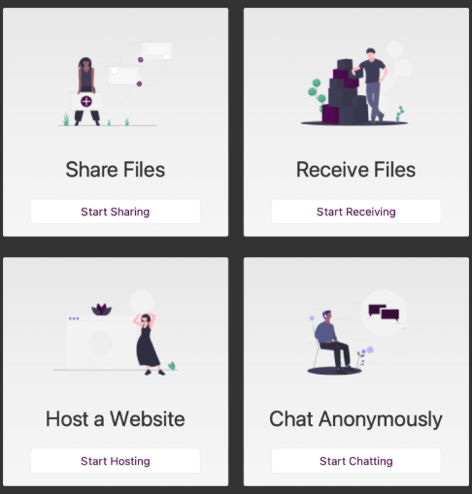
Open Technology Workshops
Let’s Play with Tor!
Let’s run the Tor Browser
https://www.torproject.org/download/
Deskop App - Windows/Linux/Mac
Mobile App - Android/iOS
http://gbrbizmqe5rluzz6nioglwyhca7jtc2gx6nkpkhi2w2wfv5obg3ta5qd.onion/
Let’s create our own Onion site
https://onionshare.org
Deskop App - Windows/Linux/Mac
Mobile App - Android/iOS
Notes:
Open source means that the source code is available to the public and has usually has a permissive license for use. This contrasts with closed source software that has a restrictive license and the source code is not available.
Sources:
https://www.turing.com/blog/open-source-vs-commercial-software-license/#:~:text=Users
%20of%20open%20source%20software,to%20users%20without%20upfront%20costs.
https://www.geeksforgeeks.org/difference-between-open-source-software-and-commercial-software/#

Slide 7

Open Technology Workshops
What is TailsOS?
Tails is a portable operating system that protects against surveillance and censorship.
https://tails.net
Tails includes:
Tor Browser with uBlock, a secure browser and an ad-blocker
Thunderbird, for encrypted emails
KeePassXC, to create and store strong passwords
LibreOffice, an office suite
OnionShare, to share files, websites, and chat rooms over Tor
Metadata Cleaner, to remove metadata from files
and many more!
Let’s create our own Tails Live USB.
https://tails.net/install/
Partner up!
Notes:
Open source means that the source code is available to the public and has usually has a permissive license for use. This contrasts with closed source software that has a restrictive license and the source code is not available.
Sources:
https://www.turing.com/blog/open-source-vs-commercial-software-license/#:~:text=Users
%20of%20open%20source%20software,to%20users%20without%20upfront%20costs.
https://www.geeksforgeeks.org/difference-between-open-source-software-and-commercial-software/#

Slide 8
Open Technology Workshops
Fin
Remember: Maintain OPSEC and good digital hygene practices!!!
Thank you for coming!

